Slide 1


Shape the future by solving problems
Pick a problem,
search for a solution,
and get involved
Where could engineering take you?

Slide 2
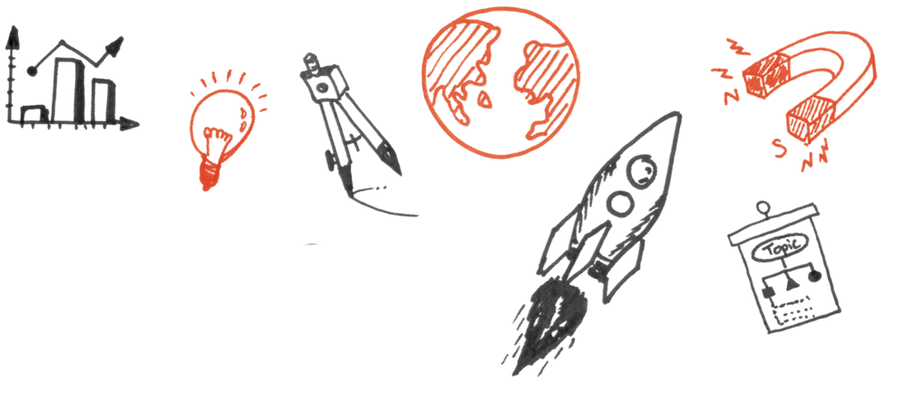
Where could engineering take you?
Notes:
Your aim: Introduce yourself and what you do.
If you feel comfortable include a personal trait i.e. ‘I also sell homemade products at markets’ or ‘I used to play saxophone in a band’.

Slide 3




What could YOU be?
Planet cleaner
Star maker
Cancer crusher
Robot ruler
Sustainability hero
Material manipulator
Time traveller
Problem Solver
HIGH SCHOOL
Notes:
Your aim: inspire about the big-picture of why engineering matters, and how engineers shape the future...without using the word ‘engineering’ in this slide.
How would you like to solve the world’s problems and shape the future?
You could be a:
Planet cleaner (clean up our environment and change what the world looks like)
Star maker (we’re not talking about the Death Star - you could use the power of sound to be the person behind the next Post Malone or Billie Eilish)
Cancer crusher (the one who finds the solution, or builds the hospital that finds a cure for cancer, or even comes up with the best way to distribute the cure)
Robot ruler (making robots that do whatever you say, or even robotic arms and legs that work better than before)
Sustainability hero (what about inventing the next biodegradable plastic or building fully off-grid buildings?)
Material manipulator (harnessing the building blocks of the universe to make planes, skyscrapers or bridges)
Time traveller (well, this hasn’t happened yet, but you could be the one!)
How do you get to be any of these - or all of these?
One step at a time, of course - starting with the foundations in your next few years of schooling.
A strong technical or scientific background sets you up to be a world changer, a problem solver and a force to be reckoned with.

Slide 4
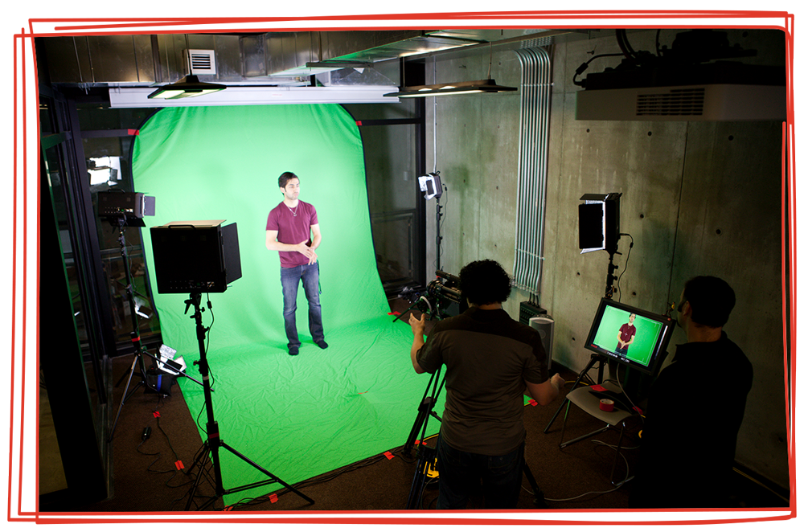






Shape the future
Pick a problem.
Search for a solution.
Get involved.
HIGH SCHOOL
Notes:
Your aim: connect engineering disciplines with answers to real-life problems that could shape the future.
Imagine growing gold on trees, playing with nanotechnology to build a tower that reaches to space, or building the world’s largest 3D printer.
It’s not the future - it’s already happening.
How? Some of the world’s best thinkers have put their minds to solving a particular problem.
What about:
Creating an alarm clock that tells your toaster to make your breakfast?
Making a robot that takes people out of danger in the workplace or out on the farm?
Finding a new way to recycle plastic in the ocean?
Building a skyscraper that won’t be affected by the forces of nature?
There are 3 simple steps to changing the world - you just pick a problem, search for a solution, and get involved.
But some of the best problem solvers have a superpower - it’s engineering.
alarm clock = electrical engineering
robot = mechanical engineering
recycling plastic = chemical engineering
building a skyscraper = civil engineering
Leaving school with a maths subject and at least one science or engineering subject will put you on the right pathway to shape your future - and the world’s.

Slide 5
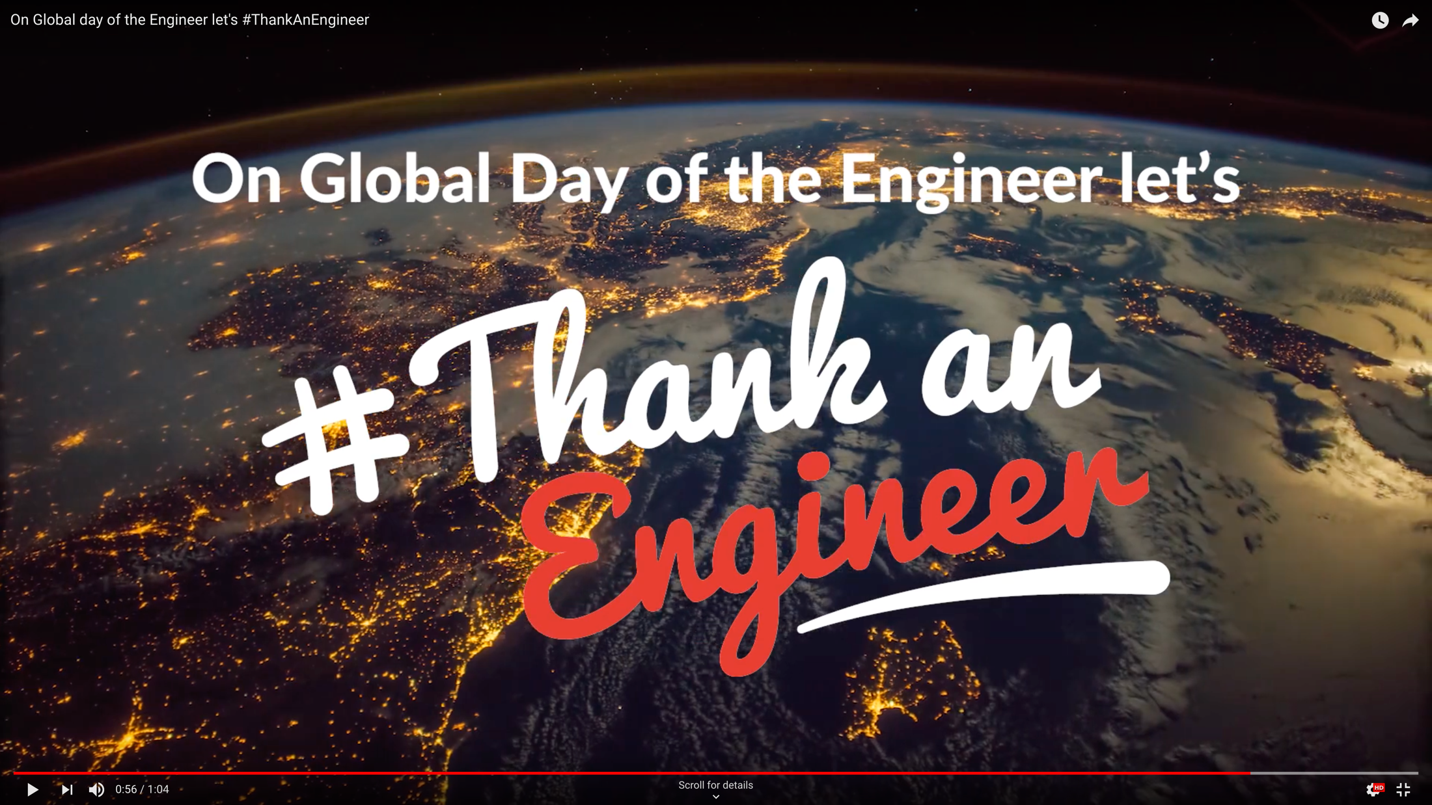
Notes:
Your aim: illustrate how engineering touches nearly every aspect of modern-day life.
Before you came to school today, did you pick up a phone or tablet and have a quick browse through Facebook? You’ve got wifi today thanks to engineers from the CSIRO here in Australia.
Did you drive past an electric vehicle (or maybe even drive in one)? Engineers have been working for years to make electric vehicles a reality.
Did you drive past roadworks or a construction site? Before anyone puts a shovel to the ground, an engineer has spent months planning and problem-solving to work out exactly what needs to happen.
<1:04 video>
While that video was made for Global Day of the Engineer, it’s pretty obvious that engineers play a key role in every single day.
Here’s another one: on the way to school, did you use a GPS? This year, a bunch of engineers are working to implement a new set of geo-positioning data that means everything in Australia moves 1.8m north-east. Without this, we won’t be able to use self-driving cars.

Slide 6


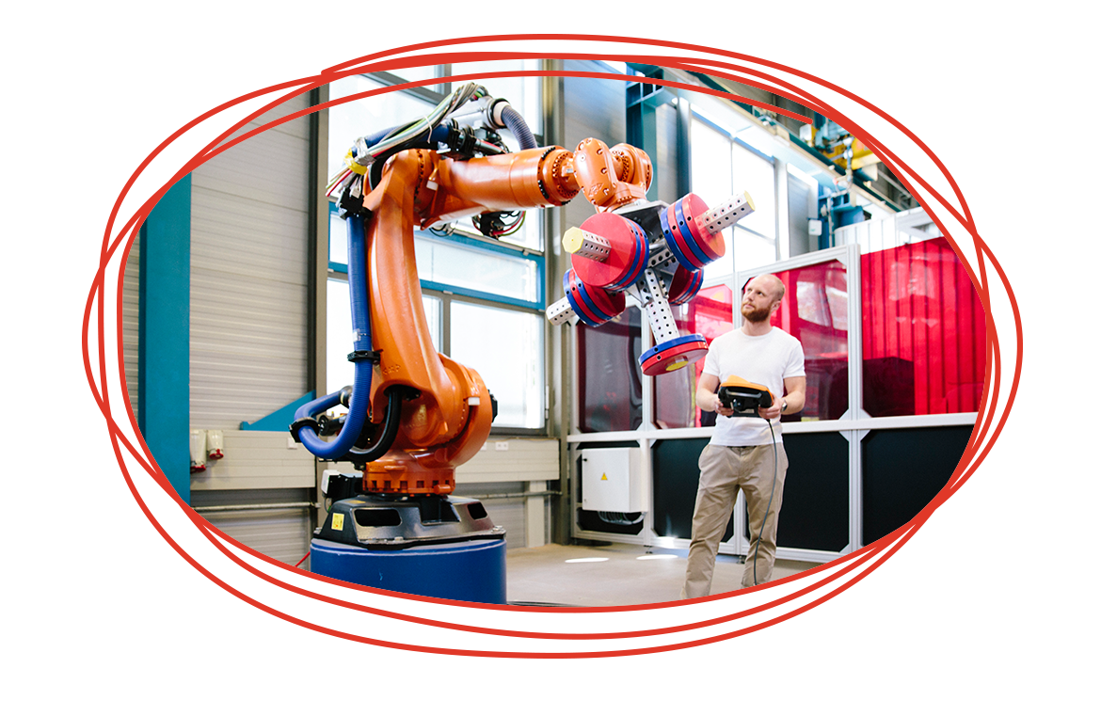
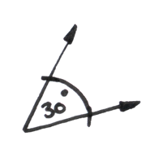
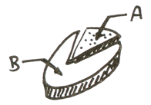
8 reasons to consider engineering
Create and shape the future
Make great money
Get a job straight after uni
Work in any industry, anywhere
Never stop learning
Beat the stereotypes
Travel the world
Solve problems all day, every day
HIGH SCHOOL
Notes:
Your aim: put engineering into a context that the students can picture themselves in.
Let’s play a game., I’m going to read a statement, and if I’m describing you, you can stand up.
Test statements: Your hair is brown <there will always be one clown that sits down/stands up at the wrong time, have a laugh if you get one of these!>
Real statements:
When you start something, you want to finish it.
You want to contribute to making the world better.
You want the freedom to work anywhere in the world.
You question things - you’ve been in trouble for asking ‘why’ too many times.
You like problems that have a definite answer (like ‘what is 2+2’, rather than ‘describe a perfect lunch’.)
You had a thing for LEGO or Minecraft.
You want to earn a good living.
<hopefully the majority of the class is now standing - these are your future engineers!>
If you’re standing, here’s why you should consider engineering. <you don’t have to read out the titles>
1. Create and shape the future
You can:
Shape the future
Turn ideas into reality
Solve the problems that our planet is facing
2. Make great money
Don’t want to be a lawyer or a doctor to make your fortune? Engineers are the next-best paid professionals, with the chance to earn more than $200k a year at the top of your game.
3. Get a job straight after uni
Nobody wants to go to uni and then end up as a barista at Maccas - with engineering, you’ve got an 83% chance of walking into an awesome full-time job straight away.
4. Work in any industry, anywhere
Engineers are involved in nearly every industry. If you’re a fan of cars, music or computers, you can choose the field of engineering that makes those things better.
5. Never stop learning
Engineers don’t stop learning - the profession is always changing, and you’ll never get bored. <this is great for a personal example - what’s changed in your field since you graduated?>
6. Beat the stereotypes
Engineering is about more than maths - you need to be a team player, creative, and business-savvy.
7. Travel the world
You can work nearly anywhere in the world with internationally recognised engineering qualifications.
8. Solve problems all day, every day
Do you love that ‘a-ha’ moment when you solve a problem that’s been bugging you? <this would be a good opportunity to share or ask the students about their biggest ‘a-ha’s>

Slide 7






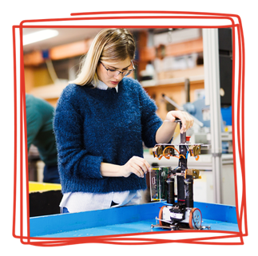
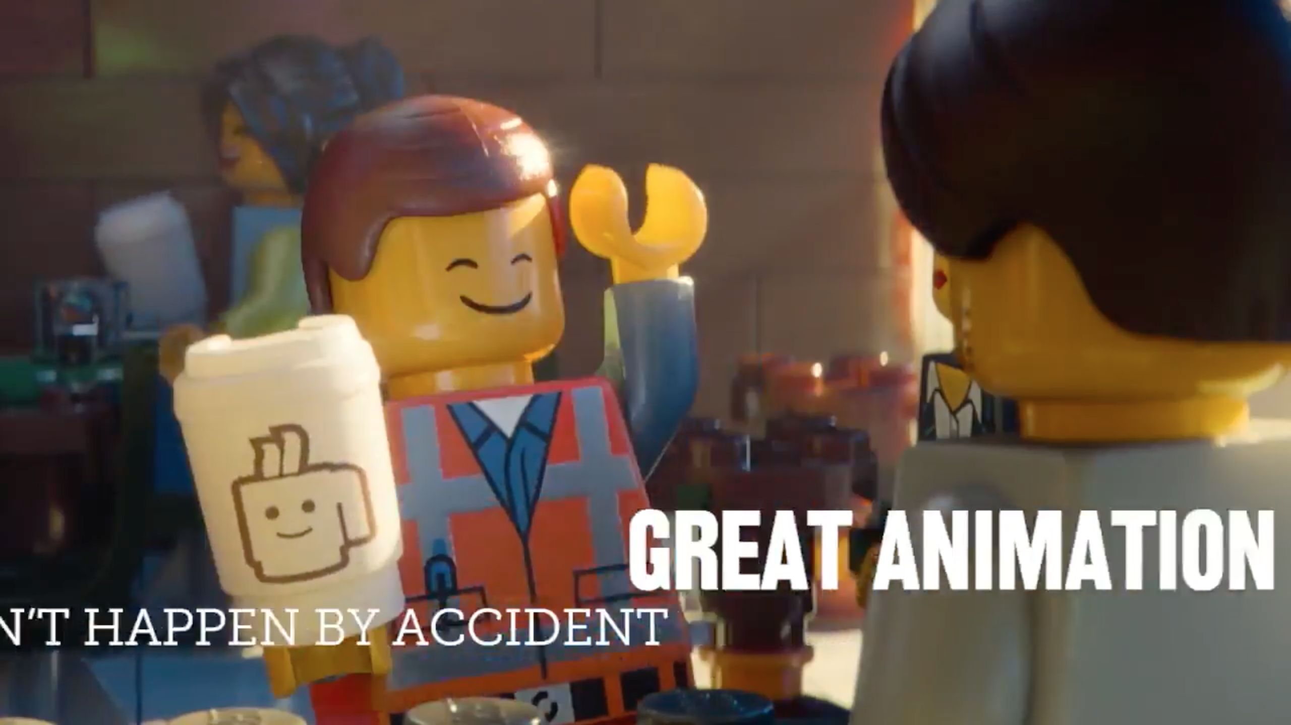

More than lab coats and geek glasses
Makeup = chemical engineer
Music = audio engineer
Cars = mechanical engineer
VFX + Animation = electrical engineer
HIGH SCHOOL
Notes:
Your aim: point out engineering careers that transcend stereotypes. Feel free to insert your own examples!
Think back to the things you said ‘yes’ to when we were all standing up.
What interests you? Put that together with your yes and you’ve got the start of a career in engineering.
You question things and you love watching makeup tutorials on YouTube - what about changing the way that beauty brands build their products, or finding sustainable fragrances as a chemical engineer?
You want to make a good living and you spend every spare minute with your AirPods blasting your favourite artist - what about shaping the sound of pop or hip-hop as an audio engineer?
You’ve always been fascinated by cars and you always question things - you could be the best at making the next generation of transport faster, bigger, deeper, smaller or smarter.
You are a wiz at maths and science and are also in awe of films with great VFX and animation - maybe you can make the next Oscar winning animated film, like Guy Griffiths.
<Click on Lego Movie image to show Guy Griffiths video>

Slide 8




What makes a good engineer?
Creativity
Critical thinking
Collaboration
Communication
HIGH SCHOOL
Notes:
Your aim: help the students understand the ‘soft skills’ that make a great engineer.
Engineers need to know more than just the technical side of things.
<Question/answer if the mood is right> - what do you think would make a good problem solver?
Look for answers along the lines of:
Use your strong imagination
See problems from different angles
Put your thoughts on paper
Visualise something and sketch it out
Get an idea across to a group of people
Break a problem down into the details
Get lost in the YouTube or Google rabbit-hole when you’re looking for information on something
Take technology to its limits and beyond
All of these things also make a great engineer.

Slide 9
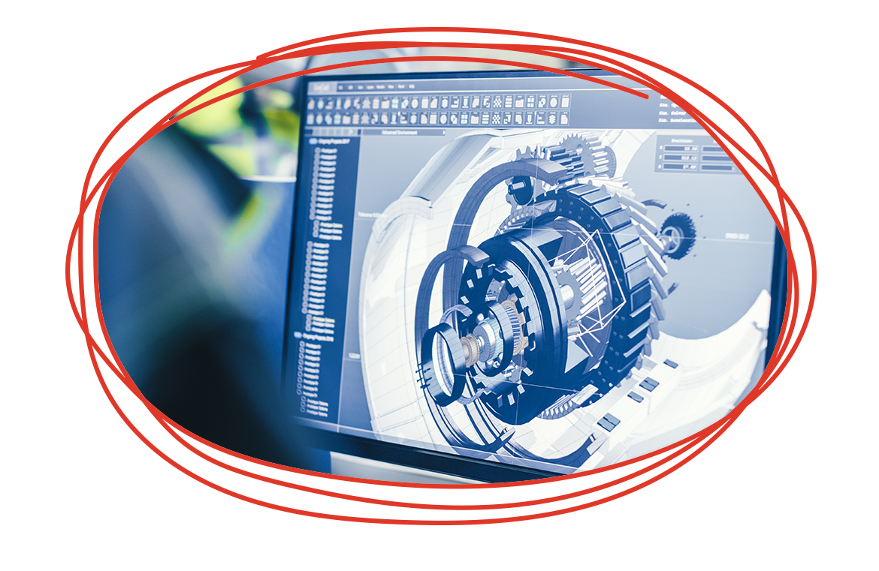
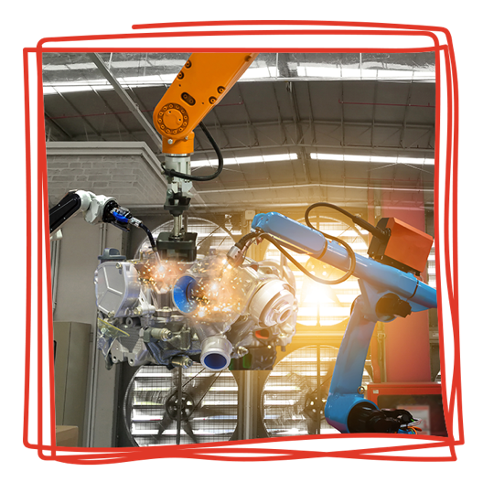

Choose your own adventure
HIGH SCHOOL + UNI
Science (Physics + Chemistry) + Math
creative/communication subjects,
such as English
ALTERNATIVE PATHWAYS
Enabling courses
Other related courses at university
TAFE/colleges/PIBT/V.E.T.
Defence
HIGH SCHOOL
Notes:
Your aim: bust the myth that getting a high ATAR score and going to university is the only way to become an engineer.
So, you want to be an engineer. How do you get there? It’s not true that you have to head straight to uni and study - while you’re laying the foundations now, you can still choose your own adventure.
<now is a great time to put in an example from your own experience!>
Sure, you can go straight from school with a strong background in Science (think Physics and Chemistry) and Maths. But don’t neglect your creative subjects - engineers still need strong communication skills, and it doesn’t hurt to be able to draw either!
If you don’t get the ATAR score you need to get in, there are other ways to still end up as an engineer.
Enabling courses that help to get your skills to the right level
Starting out in another course like Science and transferring to Engineering
Doing a TAFE qualification that gets you advanced standing
Going through a Defence traineeship
If you want it badly enough, there are a thousand roads to becoming an engineer.

Slide 10




You can’t spell TEAM without…
Tradespeople,
technicians, technologists
Engineers
Associates
Me!
HIGH SCHOOL
Notes:
Your aim: widen perceptions of who’s in a team of engineers.
Engineers don’t just work with other engineers all day - we need a whole team to get things done. This includes:
Tradespeople - often these are the people that end up putting engineers’ plans into action, like welding together parts of a bridge or wiring circuits
Technicians and technologists - these people assist engineers, putting basic engineering principles into practice to help make ideas a reality
Engineers - the ideas people, the problem solvers
Associates - these people have completed a two-year degree (rather than the full four-year engineering course) but get to work right alongside engineers
Me - <what role do you play?>
Why should you be interested in being part of an engineering team, even if you’re not an engineer?
I’m a words person - we need people who can understand a particular field of science or knowledge, and also put together ideas and information to communicate to others
I’m all about the creative - we need people who can understand data and explain it visually or kinetically
I’m interested in managing people - we need people who can put together world changing teams
I want to be in business - we need people who can scale up and turn research into profitable businesses
Even if you don’t become an engineer, there are opportunities right alongside them.

Slide 11
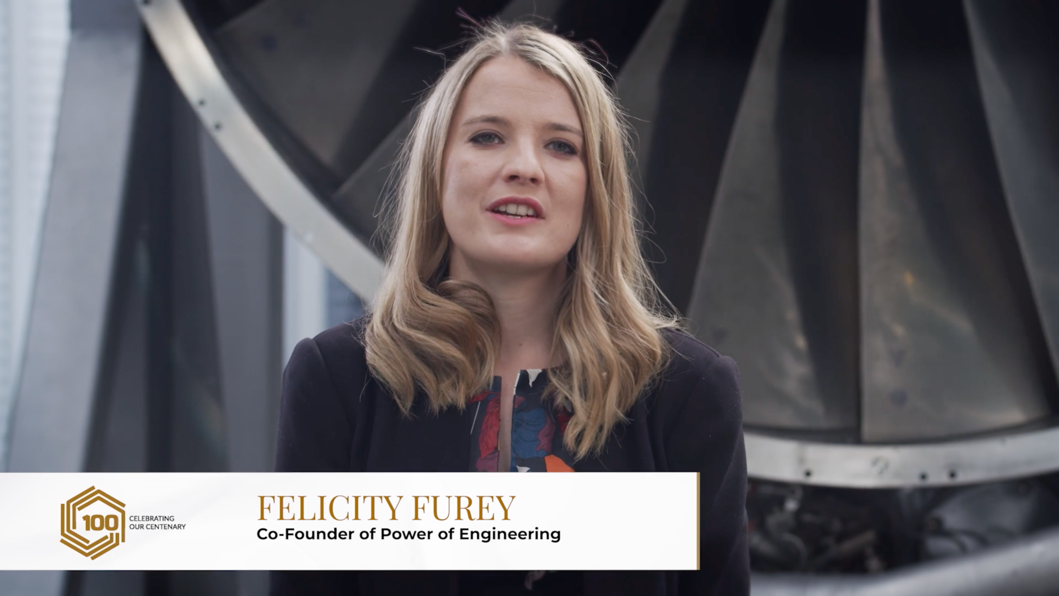
Notes:
Your aim: introduce the video and generate some interaction.
Speaking of teams - can you guess how many parts are in an average aeroplane?
What about how many people work on a Boeing 737 before it takes to the skies?
How long does it take to build a plane?
<take guesses - parts = 367,000, people = 10,000, plane = 9-11 days>
Felicity Furey (yes, that’s her real name, and no, she’s not a Marvel superhero) is working to change the stereotypes in engineering, alongside engineers like Renee. What’s this got to do with planes? Let’s take a look…
<4:20 video>

Slide 12

Notes:
Your aim: introduce the video and generate some interaction.
Can you guess how many parts are in a Formula 1 race car?
<take guesses - 16,000 parts according to McLaren>
Building a Formula 1 car sounds like a lot of work, right?
Well, a bunch of people your age have done exactly that - except in miniature - thanks to the F1 in Schools challenge.
A team from Australia won the competition in 2018 - let’s take a look. <3:19 video>

Slide 13



Engineering groups and events
Powerofengineering.org
rea.org.au/f1-in-schools
starportal.edu.au
dayofstem.com.au
HIGH SCHOOL
Notes:
Do you want to explore engineering? There are plenty of ways to get involved.
Here are some projects that you can get involved in with the help of your school:
Power of Engineering
The Power of Engineering project holds one-day events for Year 9 and 10 students around Australia.
F1 in Schools
This is a worldwide competition with 17,000 students racing to develop the fastest miniature Formula 1 car.
If you want to explore engineering on your own:
STARportal
This site is full of free and low-cost STEM activities. Log on and discover a world of online and home-based activities to spark your curiosity.
Day of STEM
A free online resource that lets you experience what a day in the life of a STEM career might look like.
There’s plenty out there, but what can you do now?
Start thinking about the problems you want to solve
There are programs and grants out there, so get involved now
Keep your head in the game - turn up, every day
What’s your passion? learn all about it

Slide 14

